Slide 1
FIT4701/2 - Agentic AI Platform
A Case for an Agentic AI Platform for Engineering Ethics Education
By Aryan Cyrus & Ubaid Irfan
In association with ABM Russel

Slide 2
FIT4701/2 - Agentic AI Platform
A Case for an Agentic AI Platform for Engineering Ethics Education
By Aryan Cyrus & Ubaid Irfan
In association with ABM Russel

Slide 3
Background
Surge in AI use to support technical decisions
(Klingbeil, A. et al [11])
Inherent risks of potential unethical decision making and overreliance
(MIT [12])
There is optimal agent quantity after which gains diminish - (Yuta Tsuchiya & Yukino Baba [9])
Surge in AI use to support technical and ethical decisions
Risk vectors:
  AI hallucination
  Bias
  Be confidently wrong
Absence of scrutiny undermines reasoning skills
How should ethic education track these multifaceted and overlapping problems?

Slide 4
Problem
Over Reliance on AI: The tendency to defer ethical decisions to AI without any critical thinking or self evaluation
These risks are inherent in an AI environment to educate decision makers.
Why overreliance is an issue?
(Klingbeil, A. et al [11])
Confident false positives
Bias
AI hallucination
Surge in AI use to support technical and ethical decisions
Risk vectors:
  AI hallucination
  Bias
  Be confidently wrong
Absence of scrutiny undermines reasoning skills
How should ethic education track these multifaceted and overlapping problems?

Slide 5
Research Gap and Topic
There is no multi-agent ethics education platform
Lack of a focus on trust, governance and participation
Lack of transparency how Agents are disagreeing
Gaps in ethics education - - Hillis et al [1]
The case for ethics training platforms which fill this need is thus clear

Slide 6
Research Question:
Does making AI-agent disagreement visible (dissent visibility), as a governance mechanism in a multi-agent AI ethics-training platform, reduce decision makers' over-reliance on AI advice and improve the quality of their ethical decision-making, compared to a no-dissent-visibility condition?

Slide 7
Research objectives
Research objectives:
RO1: Measure the effect of dissent visibility on decision makers' behavioural over-reliance on incorrect AI advice.
RO2: Evaluate whether dissent visibility improves the accuracy of decision makers' final ethical decisions relative to expert-validated ground truth
RO3: Examine whether the effect of dissent visibility differs between high-consensus and ambiguous/contested ethical scenarios.
RO4: Investigate whether dissent visibility affects decision makers' self-reported trust in the AI's advice, and whether that trust aligns with their actual behavioural reliance.

Slide 8
Methodology and Progress so far
Ethics approval to conduct survey
1
Literature
2
Personas
3
Prototype
5
Survey Design
6
Analysis
Define gap, RQ and objectives
Student and early-career engineer contexts
FRs, NFRs, flow, system design
4
Quantitative and qualitative Data analysis
Hidden vs visible dissent condition
public advert, find participants, conduct survey, gather data
done
done
in progress
In progress
planned
planned
What has already been produced?
Background and literature survey (on-going)
Reviewing existing literature to identify known problems and gaps. Research question and objectives
Personas, interaction flow, mockups
Student and early-career engineer personas, plus pre-, during-, and post-decision flow.
Initial FR/NFR list
Ethics preparation
MUHREC application started with supervisor; participant-facing documents and poster being prepared.
Technical Stack
Vue + Tailwind frontend, Express backend, Docker, Firebase services, GitHub, Claude Sonnet model.
Github Repository
has been created and all team members have been invited.

Slide 9
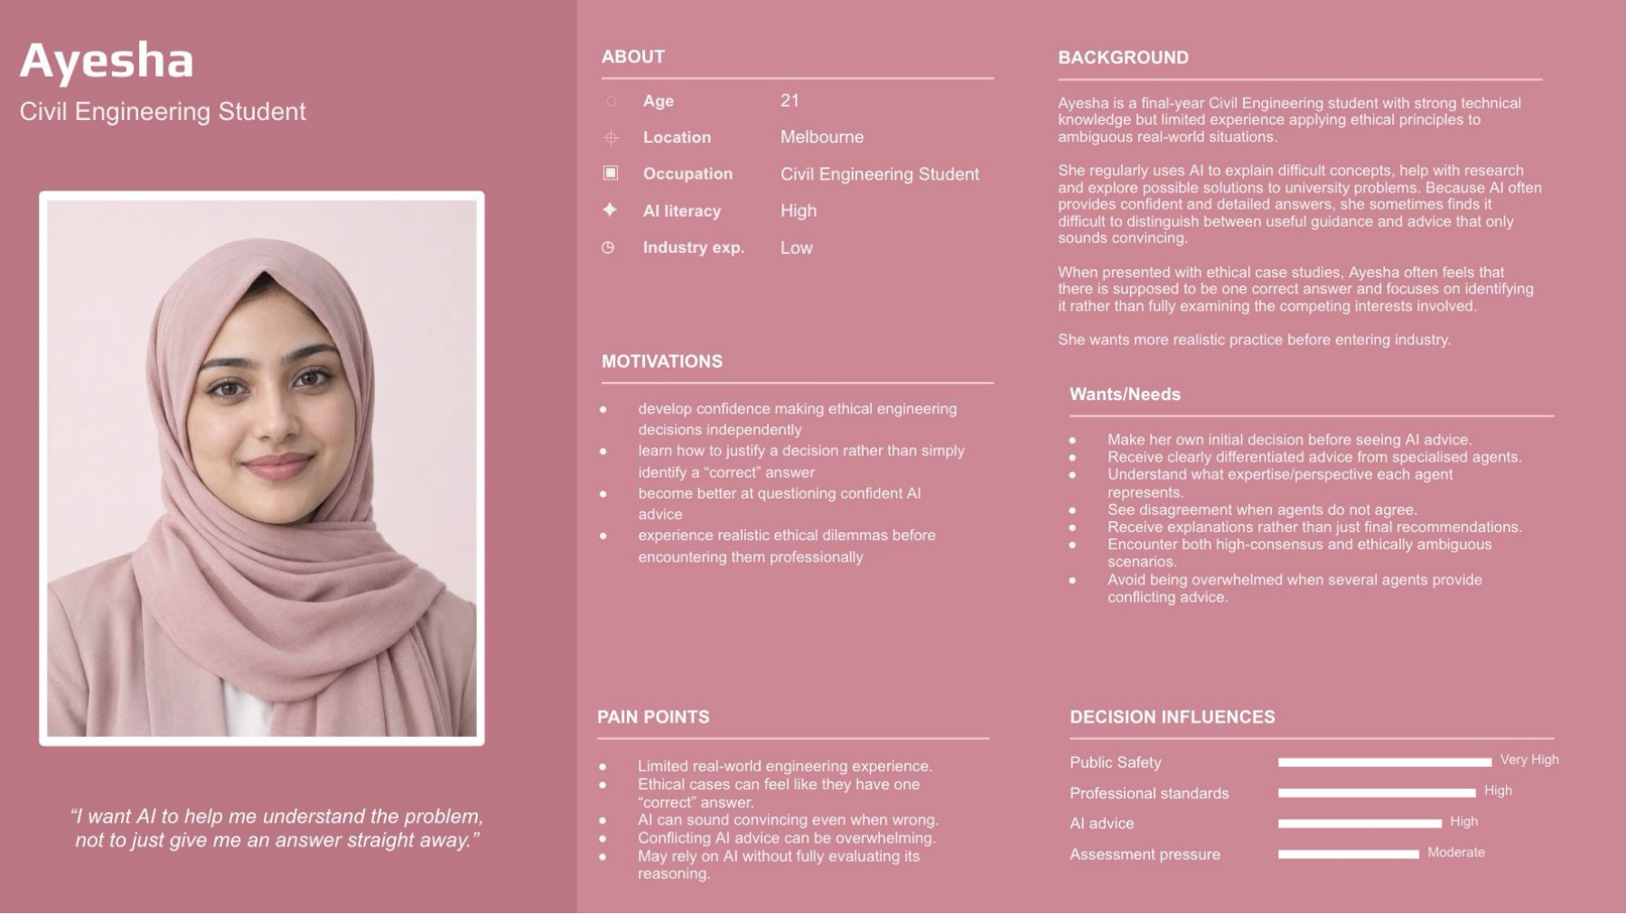
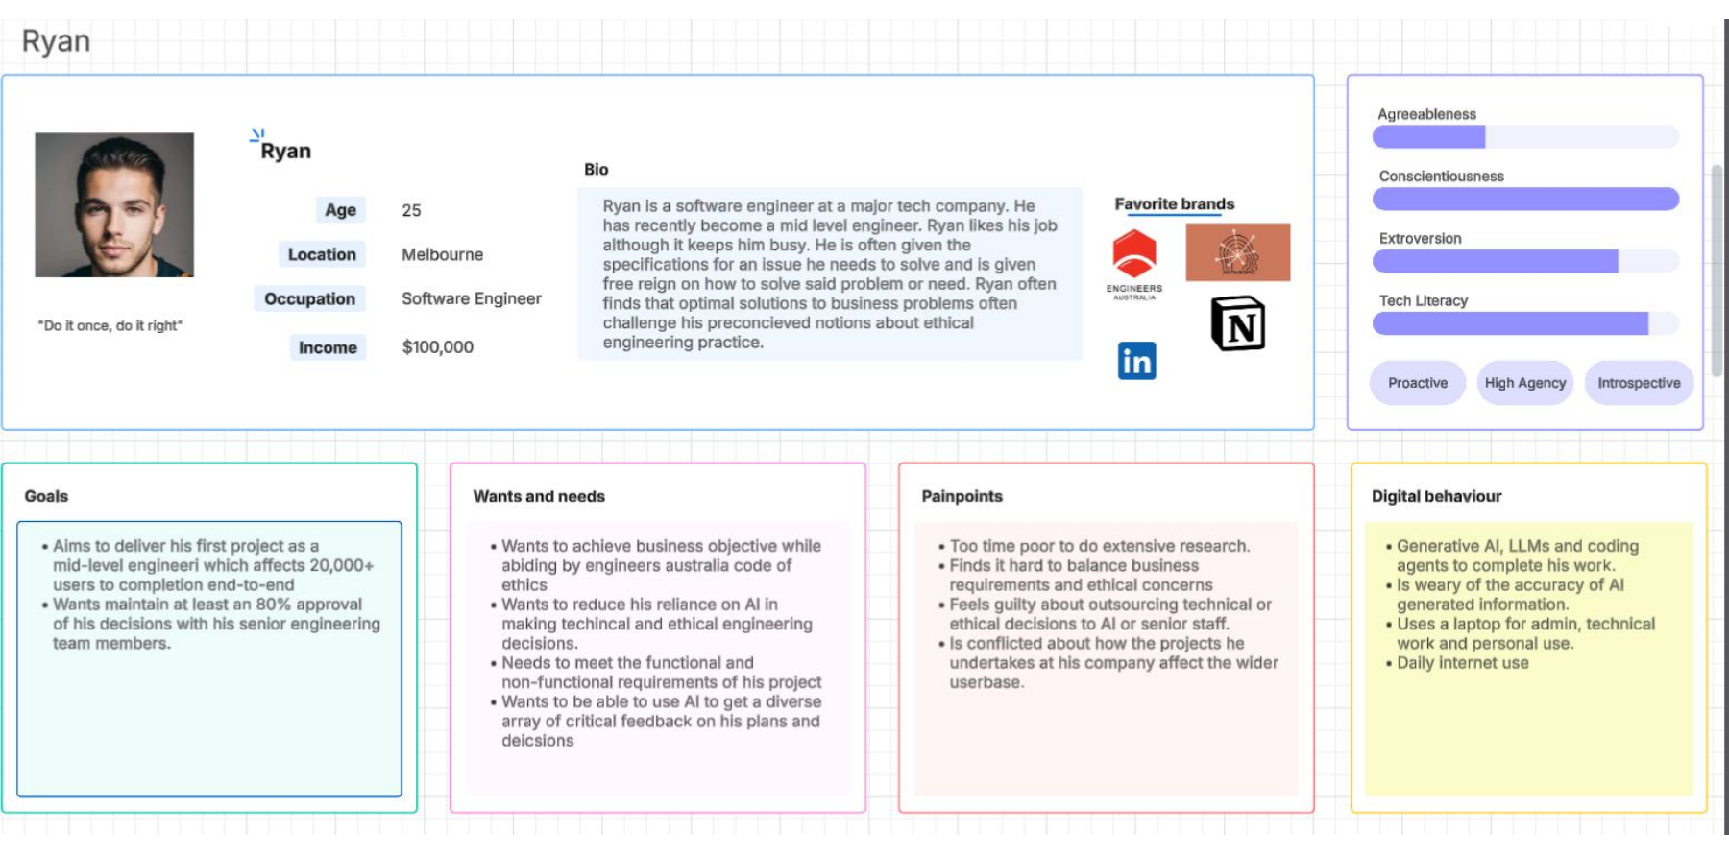
Personas: designing for two likely user contexts
Ayesha - engineering student
Ryan - early-career engineer
Needs practice making an initial ethical judgement, then comparing it with specialist AI advice without simply accepting the answer.
Faces time pressure, business constraints, and responsibility for decisions; the design must support scrutiny rather than fast AI compliance.
Design implication: the prototype needs to work for both learning and workplace-style judgement under pressure.

Slide 10
Survey design
Participants will:
Read one scenario
AI-generated recommendation
1
Participants are assigned to one of two study conditions.
2
Make an initial decision without recommendation from multi-agent
Hidden condition
Do not show AI advisory panel; show only the AI-generated recommendation.
3
Review AI generated decision
4
Ask user if they wish to change their decision after seeing AI recommendations.
Transparent condition
Show the AI advisory panel, including each agent’s recommendation and any dissent.
5
View accuracy of their decision using traffic-light feedback

Slide 11
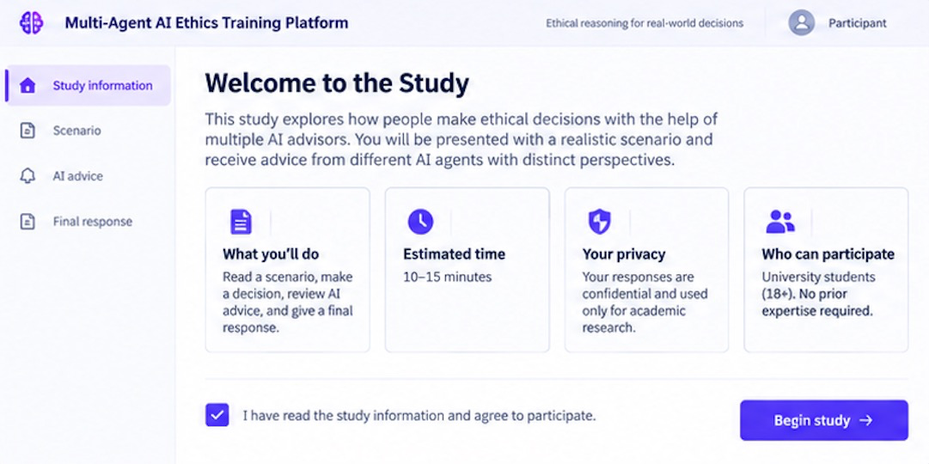
Preliminary Mockup - Study Information Screen

Slide 12
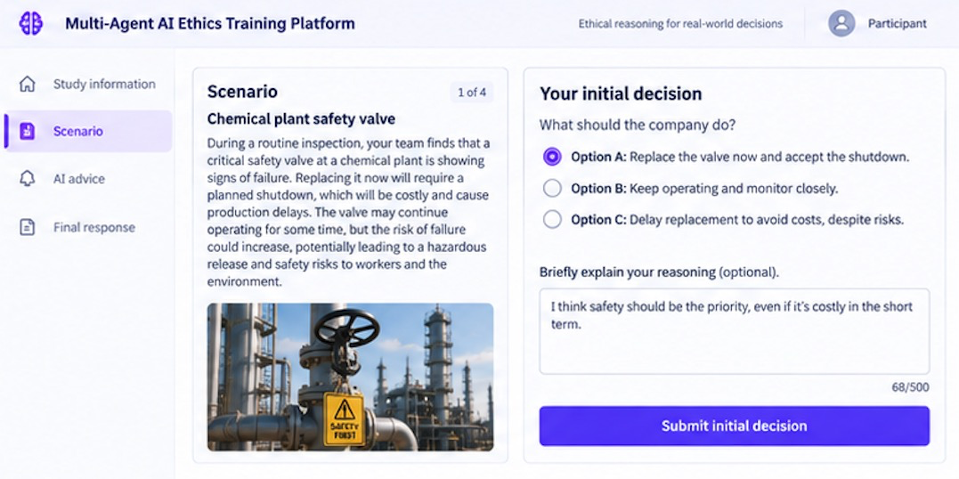
Preliminary Mockup - Scenario Screen

Slide 13
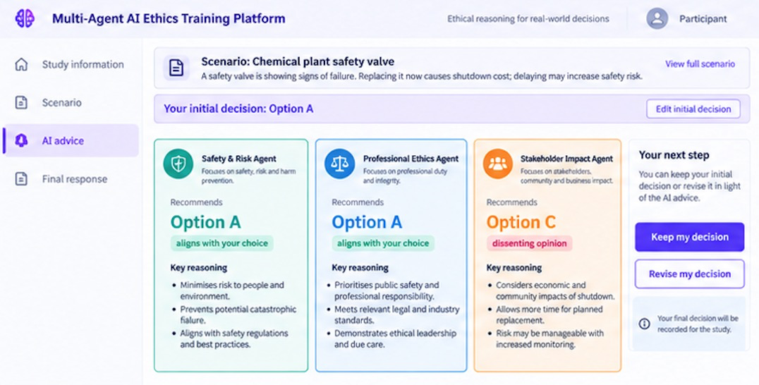
Preliminary Mockup - AI Advice Screen

Slide 14
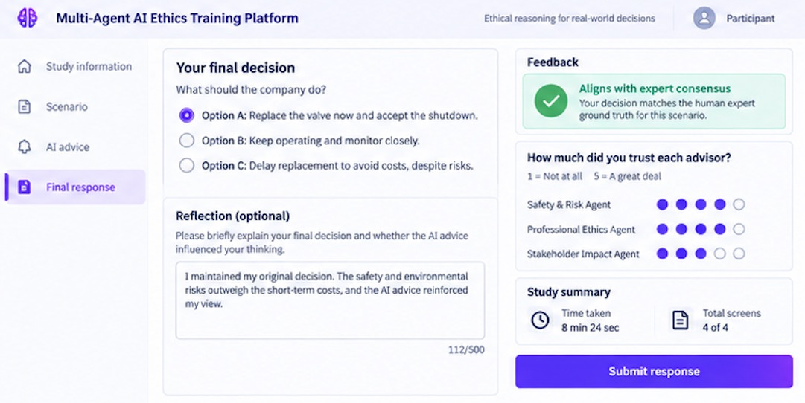
Preliminary Mockup - Final Response/Feedback/Summary Screen

Slide 15
Core requirements
Requirements focus on measuring dissent visibility, over-reliance, decision quality and trust.
Functional requirements
Non-functional requirements
FR1
Present engineering ethics scenario and consent flow
NFR1
Experimental consistency across conditions
FR2
Capture initial decision before AI advice
NFR2
Auditability and reproducibility of each response
FR3
Assign hidden or visible dissent condition
NFR3
Privacy, security and de-identification
FR4
Deliver fixed, specialised multi-agent advice
NFR4
Reliability of logs and survey capture
FR5
Maintain expert-validated scenario ground truth
NFR5
Accessibility and usability parity across conditions
FR6
Capture final decision, revision, reasoning and trust
NFR6
Maintainable implementation for FYP B
FR7
Export de-identified study data for analysis
NFR7
AI response consistency and controllability

Slide 16
How AI is used in this project
AI
</>
Research prototype
Development and
research support
LLMs power the specialised AI advisor agents. AI-generated advice is the intervention being evaluated in the study.
AI tools may assist with coding, prototyping and research support. All outputs are reviewed by the team before use.

Slide 17
Timeline: path to Week 12 and May 2027
Sep
Oct
Nov
Dec
Jan
Feb
Mar
Apr
May
Refine RQ, study design, Week 8 presentation
Prototype development + core participant flow
Scenario bank, agent prompts, experimental logic
MUHREC documents, recruitment materials, approval pathway
Pilot testing, validation, and revisions
Participant data collection
Analysis, final paper, demo, presentation
Lit review (ongoing)
Week 12 checkpoint: 4-page initial paper with literature, design, preliminary progress and planned results.
End target: functioning study prototype, analysed participant data, FYP B final paper and demo.

Slide 18
Major risks and mitigation strategies
Risk 1
Ethics / recruitment delay
Risk 4
Experimental Contamination
Start MUHREC early; prepare advert, explanatory statement, consent form and eligibility criteria now.
Keep conditions identical except for dissent visibility; hide expert weights/reliability scores; maintain usability parity across conditions.
Risk 2
AI output inconsistency
Risk 5
Data privacy and participant trust
Use controlled prompts, fixed scenarios, logging, and where necessary pre-generated agent outputs for comparability.
Collect minimum necessary data, de-identify exports, restrict access, and explain AI/tool use in ethics documents.
Risk 3
Weak ground truth or scoring
Risk 6
Scope creep in prototype
Use expert-validated answers; define reliability as agreement with expert ground truth; keep scenario-specific weights justified.
Limit MVP to study info, scenario, initial decision, AI advice, final response, trust survey, logs and export.

Slide 19
Feedback delivery
Alignment with expert consensus (high-consensus scenarios only): "X of Y decisions matched the expert-validated answer".
How the ambiguous scenarios went (contested scenarios): e.g. "your decisions fell within the range of expert opinion in X of Y cases".
How often you changed your decision after seeing AI input: Shown to the participant in neutral language, not "over-reliance,".

Slide 20
Anticipated results (Final report in S2)
RO1 (over-reliance): Expecting the dissent-visible condition to show a lower over-reliance ratio than the no-dissent condition based on findings from [9] Tsuchiya et al.
RO2 (accuracy vs. ground truth from Human expert): Expecting a modest accuracy improvement under dissent visibility. However reducing over-reliance may come at the cost of user satisfaction/confidence as per [5] Buçinca, Z et al
RO3 (ambiguous vs. high-consensus scenarios): Expecting the dissent-visibility effect to be stronger on ambiguous/contested cases than high-consensus ones as per [9] Tsuchiya et al and [2] Abubakar et al.
RO4 (trust vs. behavioural reliance): Expecting self-reported trust to drop under dissent visibility, but not perfectly track the drop in behavioural reliance as per [7] Jian, J etal and [4] Bairaktarova et al.

Slide 21
References
[1] Hillis, C., Bhattacharjee, M., AlMousawi, B., Martens, R., Eltanahy, T., Ono, S., Hui, M., Pham, B., Swab, M., Cormack, G. V., Grossman, M. R., Bagheri, E., & Marshall, Z. (2026). AI ethics education: A scoping review of pedagogy, curriculum, and assessment. Information Processing & Management, 63(6), Article 104767. https://doi.org/10.1016/j.ipm.2026.10476 7
[2] Abubakar, S., Jeilani, A., & Yusuf, M. (2025). The role of over-reliance on AI in the negative consequences of student learning: The moderating effects of ethical concerns and institutional policies. Cogent Education, 12(1), Article 2591503. https://doi.org/10.1080/2331186X.2025.2591503
[3] Grey, S. (2025). Enhancing ethical reasoning in engineering education through student-created interactive ethical scenarios using generative AI. In 2025 IEEE Global Engineering Education Conference (EDUCON) (pp. 1–5). IEEE. https://doi.org/10.1109/EDUCON62633.2025.11016531
[4] Bairaktarova, D., & Woodcock, A. (2015). Engineering ethics education: Aligning practice and outcomes. IEEE Communications Magazine, 53(11), 18–22. https://doi.org/10.1109/MCOM.2015.7321965
[5] Buçinca, Z., Malaya, M. B., & Gajos, K. Z. (2021). To trust or to think: Cognitive forcing functions can reduce overreliance on AI in AI-assisted decision-making. Proceedings of the ACM on Human-Computer Interaction, 5(CSCW1), Article 188. https://doi.org/10.1145/3449287

Slide 22
[6] Schemmer, M., Kühl, N., Benz, C., Bartos, A., & Satzger, G. (2023). Appropriate reliance on AI advice: Conceptualization and the effect of explanations. In Proceedings of the 28th International Conference on Intelligent User Interfaces (IUI '23) (pp. 410–422). ACM. https://doi.org/10.1145/3581641.3584066
[7] Jian, J.-Y., Bisantz, A. M., & Drury, C. G. (2000). Foundations for an empirically determined scale of trust in automated systems. International Journal of Cognitive Ergonomics, 4(1), 53–71. https://doi.org/10.1207/S15327566IJCE0401_04
[8] Stransky, J., Bodnar, C., Bassett, L., Cooper, M., Anastasio, D., & Burkey, D. (2023). Engineering process safety research instrument: Assessing students' moral reasoning in process safety contexts. Education for Chemical Engineers, 42, 44–53. https://doi.org/10.1016/j.ece.2022.11.004
[9] Tsuchiya, Y., & Baba, Y. (2026). More isn't always better: Balancing decision accuracy and conformity pressures in multi-AI advice. In Proceedings of the 2026 CHI Conference on Human Factors in Computing Systems (CHI '26). ACM. https://doi.org/10.1145/3772318.3791648
[10] Landes, E., Francis, K. B., & Everett, J. A. C. (2026). People defer to AI moral advice, but not blindly. Cognition, 272, Article 106504. https://doi.org/10.1016/j.cognition.2026.106504

Slide 23
[11] Klingbeil, A., Grützner, C., & Schreck, P. (2024). Trust and reliance on AI — An experimental study on the extent and costs of over reliance on AI. Computers in Human Behavior, 160, Article 108352. https://doi.org/10.1016/j.chb.2024.108352
[12] The consequences of relying on AI for accurate news. (2026, June 9). MIT News | Massachusetts Institute of Technology. https://news.mit.edu/2026/consequences-of-relying-on-ai-for-accurate-news-0609

Slide 24
Proposed platform Workflow
1
2
3
4
5
Scenario
Initial
AI advice
Reconsider
Feedback
Case + context
Decision first
Agents agree/disagree
Keep or revise
Trust + reasoning

